Slide 1
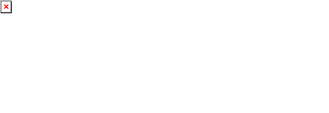
Agent Activity Chart
6/26/2023 3:29 AM
Print User : selenium.automation
Page 1 of 3

Slide 2
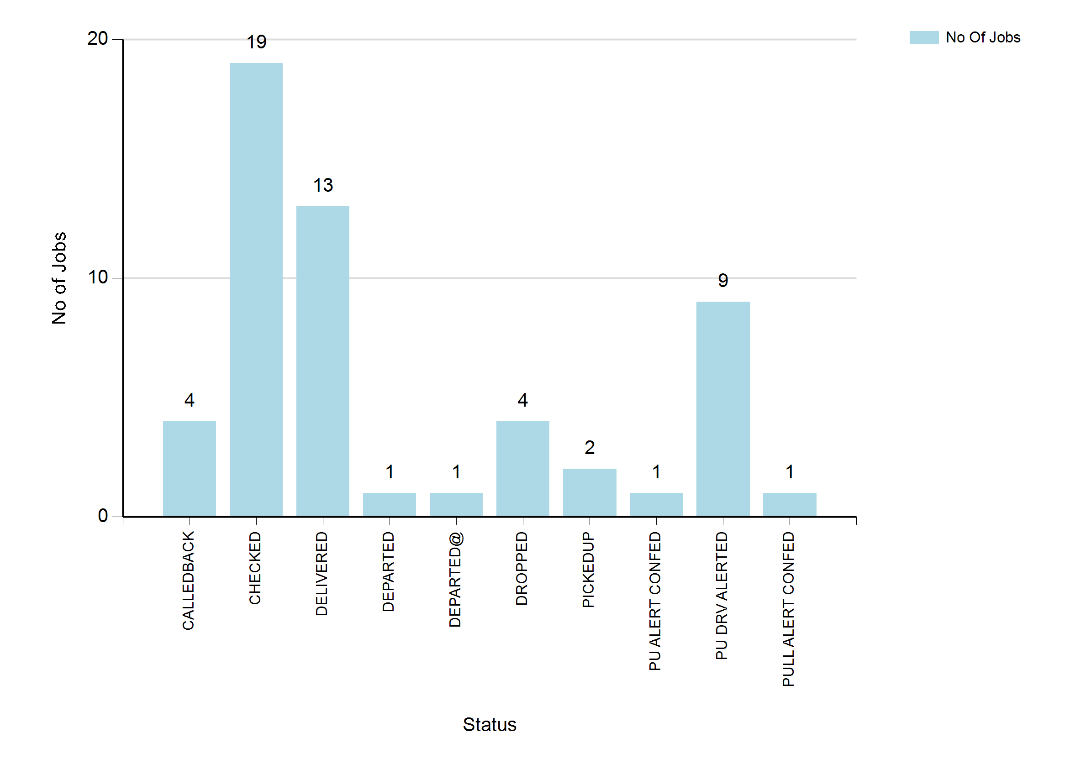
6/26/2023 3:29 AM
Print User : selenium.automation
Page 2 of 3

Slide 3
6/26/2023 3:29 AM
Print User : selenium.automation
Page 3 of 3

